Slide 1
PJ SEO Specialists
Developing and Optimizing Visitor-friendly Websites for a First-class User-experience and Visibility on Google and Bing
ECommerce Portal Developers

Slide 2
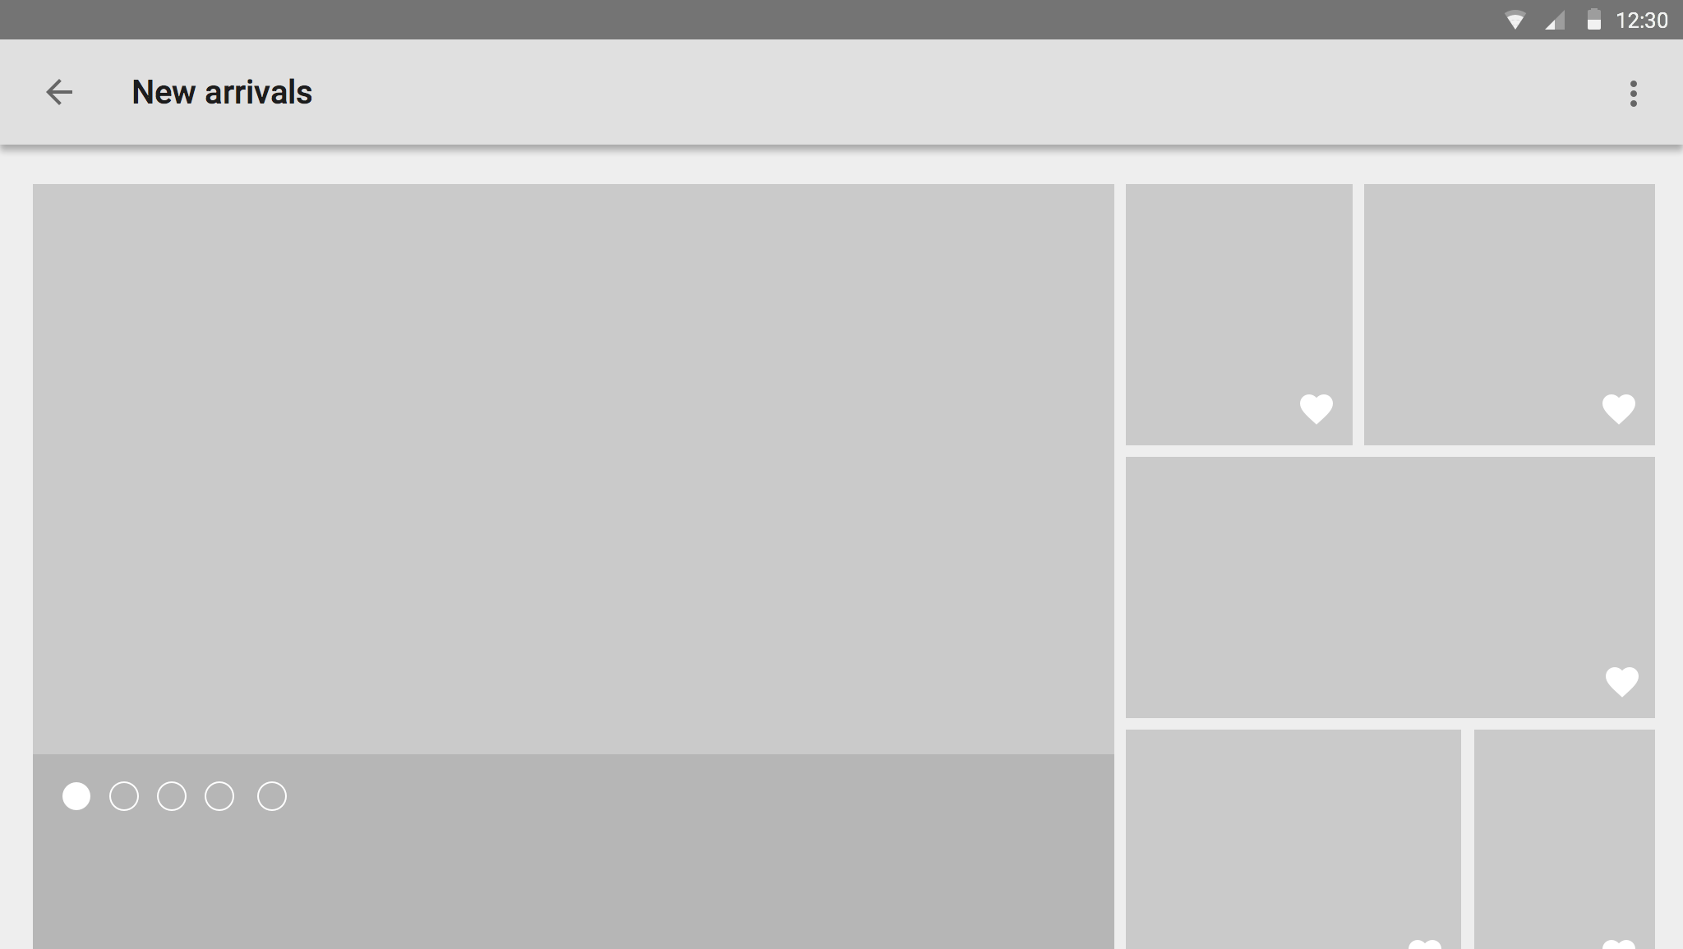
The Ones Who Call You Through References
There are 4 Types of Potential Customers
The Ones You Approach
The Ones Who Search Online Mainly On Desktops To Look for Suppliers
Do You Want To Tap The Last Two By Having a Website ?
And The Ones Who Search The Internet Mainly On SmartPhones To Look for Sellers or Service Providers
Website Creation Service Providers

Slide 3
Websites : What Matters and How Much
Informative Content and Easy Navigation
Mobile
Phone
Compatibility
Internal & External Links
Design and Animations
Online Marketing Agency

Slide 4
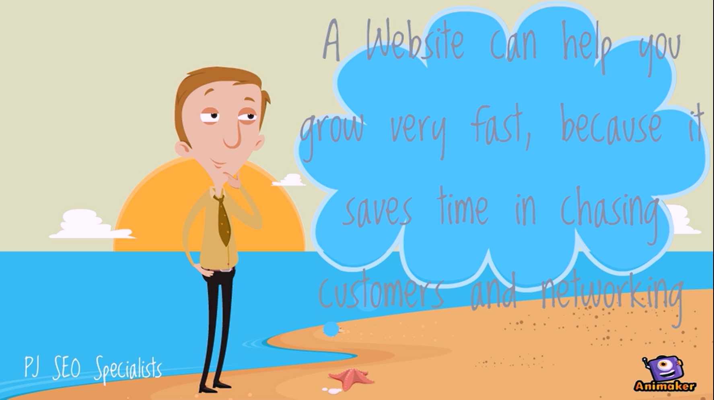
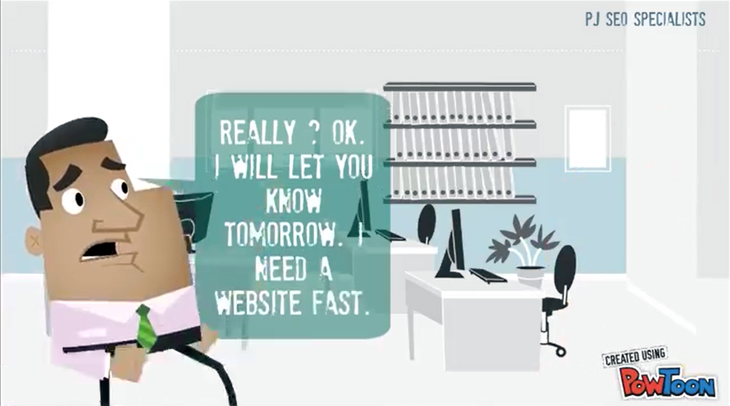
Top Class Websites Bring Business Success
Do You Want to Expand Your Operations ? Do You Need New Visitors from Remote Markets You Cannot Travel To ?
A Quality Website Can Make That Happen
Websites Create an Option to Market Content

Slide 5
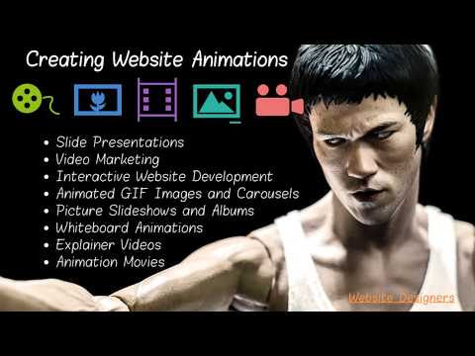
A Prime Showroom is Your Top Salesman - Buyers Walk-in On Their Own After Seeing Your Signage
So Are Premium Portals - Prospects Visit The Same On Their Own After Viewing Search Engine Listings

Slide 6
Benefits Of Website Building
Your Best Sales Tool. Most Buyers Use Internet for Finding Informative Websites. Traditional Marketing Methods Are Very Expensive Now.
Help You Market Your Content With New Customers 24/7/365. Eliminate The Wasted Effort In Approaching Consumers Who Do Not Need Your Service.
Create A World-Wide Visibility And Automatic Lead Generation For Your Profession. Provides You An Edge Over Competitors Without Websites.
Help You Focus On Improving Service By Saving The Time Required In Pre-Sales And Chasing Clients.

Slide 7
Website Promotion Magnifies the Effect of Social Media Marketing
Our YouTube Channel
Slides.com Profile
Facebook Business Page
Location On Bing Maps
Pinterest Business Account
Google Maps Profile
Our Quora Profile
Our Twitter Account

Slide 8
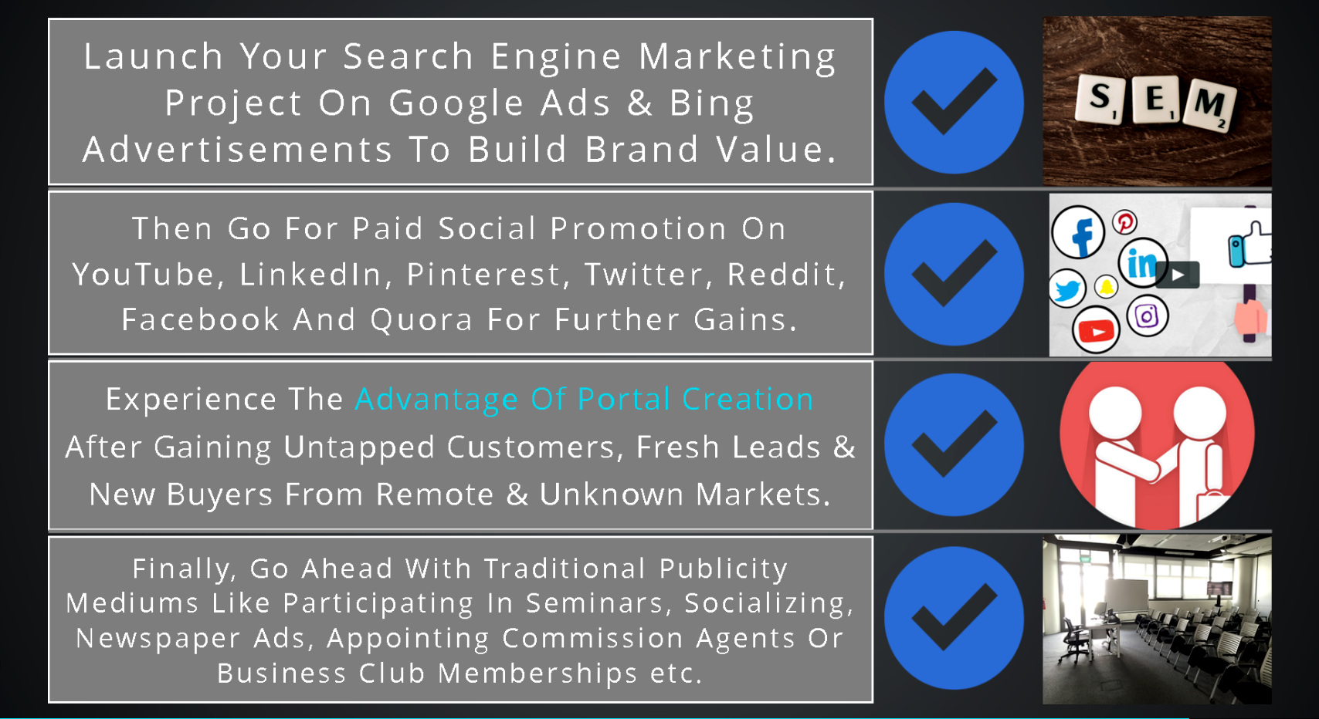
Traditional vs Content Marketing
Digital Portfolio Makers In India

Slide 9
PJ SEO Specialists
Contact Us
Portal Builders In India
Websites help you find new and unknown customers from untapped and remote markets.
That provides you an option to eliminate old clients which either do not pay on time or else are difficult to deal with.
Websites generate targeted leads, as most visitors reach your site only if looking for the category of service you provide, hence saving you the effort in approaching non-interested prospects.

